Slide 1
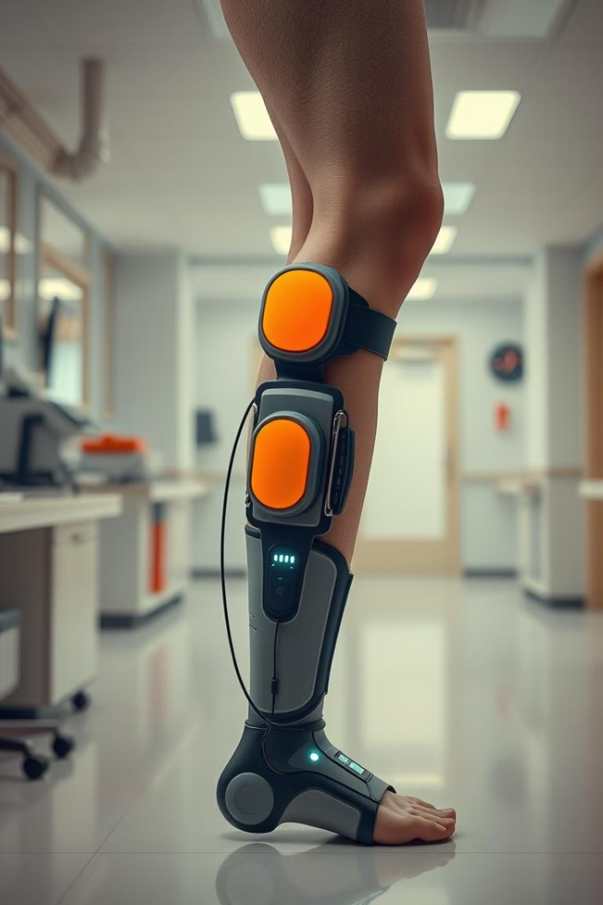

SmartStride: Revolutionizing Lower Limb Recovery
Advanced Status Detection for Enhanced Rehabilitation
作者：joki zhang

Slide 2

Project Overview
1
Goal
2
Method
Revolutionize lower limb recovery.
Advanced status detection.
3
GitHub
Project repository

Slide 3

Latest News: Database Built
2025-04-21
Database has already built.
[Read more]

Slide 4

Data Flow and Business Logic
2025-04-15
2025-04-15
Data flow design.
Business logic design.
Document
Data Design

Slide 5
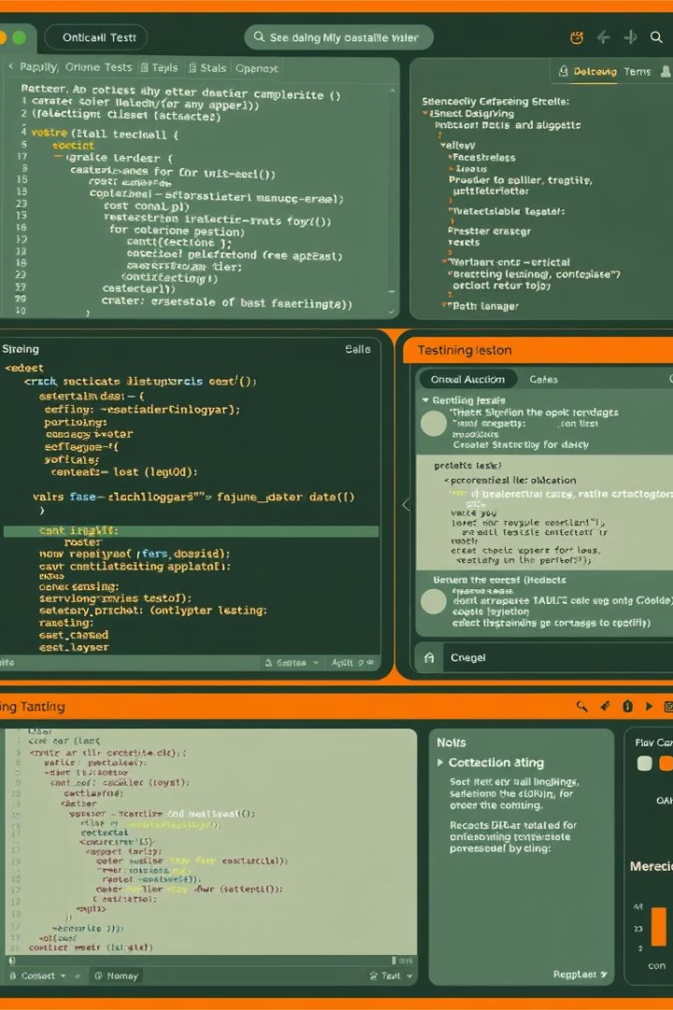


Test Cases
2025-04-15
Documents
Test cases designed.
Test_Case_Design

Slide 6
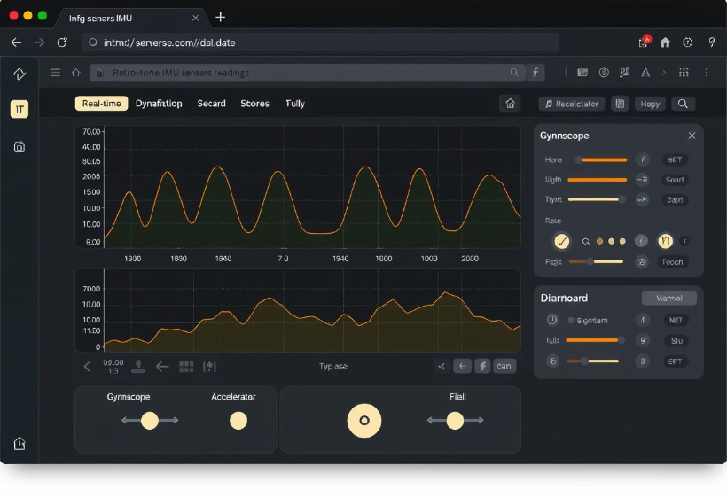
Web IMU Data Collection Demo
2025-04-13
Web IMU data collecting Demo

Slide 7




Preliminary Data Processing
2025-04-08
Data processing.
System Architecture
Technical roadmap.
2025-04-08
System architecture designed.

Slide 8
Requirement Analysis
2025-03-31
1
Requirement Analysis Specification
Document
2
SRS 1.0
2025-03-23
3
Data part.

Slide 9
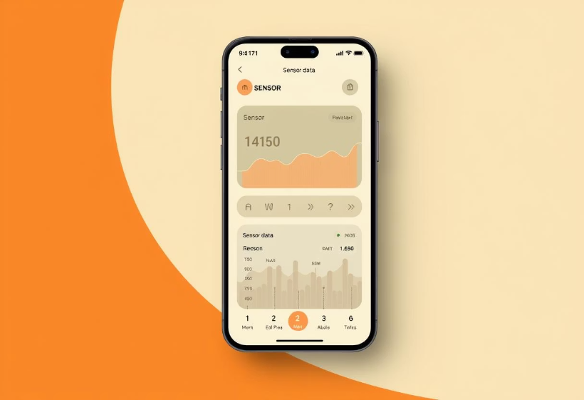
Mobile Application Design
2025-03-26
Tips for future work.

Slide 10
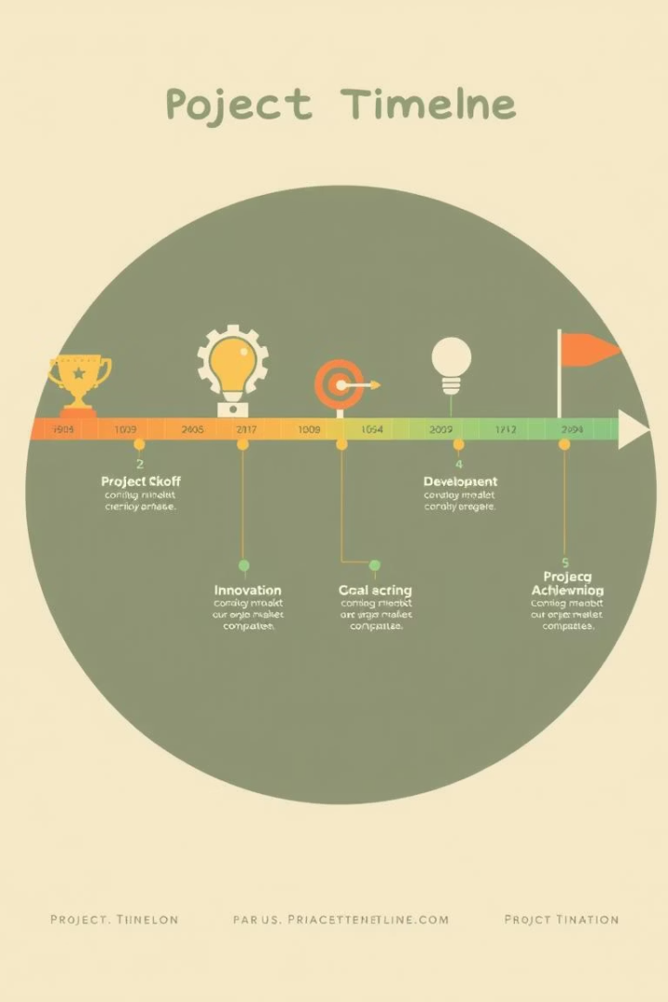
Project Milestones
1
2025-03-18
Detailed use cases.
2
2025-03-16
Real-time processing and analysis.
3
2025-03-15
Project's use case diagram.

